Slide 1

Chapter 3
Cascading
Style Sheets

Slide 2
3.1 Introduction
The CSS1 specification was developed in 1996
CSS2 was released in 1998
CSS3 is on its way
CSSs provide the means to control and change presentation of XHTML documents
CSS is not technically XHTML, but can be embedded in XHTML documents
Style sheets allow you to impose a standard style on a whole document, or even a whole collection of documents
Style is specified for a tag by the values of its properties

Slide 3
3.2 Levels of Style Sheets
There are three levels of style sheets
  Inline style sheets- specified for a specific occurrence of a tag and apply only to that tag
  – This is fine-grain style, which defeats the purpose of style sheets - uniform style
  Document-level style sheets - apply to the whole document in which they appear
  External style sheets - can be applied to any number of documents
When more than one style sheet applies to a specific tag in a document, the lowest level style sheet has precedence
  In a sense, the browser searches for a style property spec, starting with inline, until it finds one (or there isn’t one)
If no style sheet information is specified, the browser default property values are used
Sometimes the browser may not be capable of using the property values specified in a style sheet

Slide 4
3.2 Levels of Style Sheets (continued)
Inline style sheets appear in the tag itself
Document-level style sheets appear in the head of the document
External style sheets are in separate files, potentially on any server on the Internet
  Written as text files with the MIME type text/css
  Two types of tags can be used
  <link> tag– which appears only in the <head>
  @import tag which appears only at the beginning of the content of the style element

Slide 5
3.2 Linking an External Stylesheet
A <link> tag is used to specify that the browser is to fetch and use an external style sheet file
<link rel = "stylesheet" type = "text/css"
href = "http://www.wherever.org/termpaper.css">
</link>
External style sheets can be validated
  http://jigsaw.w3.org/css-validator/
  validator-upload.html

Slide 6
3.3 Style Specification Formats
Format depends on the level of the style sheet
Inline:
  Style sheet appears as the value of the style attribute
  General form:
  style = "property_1: value_1;
  property_2: value_2;
  …
  property_n: value_n;“
  Example:
  <h1 style ="font-size:25pt; font-style:italic;">
  This is inline style example</h1>

Slide 7
3.3 Format for Document-level
Style sheet appears as a list of rules that are the content of a <style> tag
The <style> tag must include the type attribute, set to "text/css“
Comments in the rule list must have a different form - use C comments (/*…*/)
General form:
  <style type = "text/css">
  <!--
    rule list
  -->
  </style>

Slide 8
3.3 General Form, Document Level
Format of the rules:
selector {list of property/values}
  Selector indicates the tag or tags affected by the rule
  Each property/value pair has the form:
  property: value
  Pairs are separated by semicolons, just as in the value of a <style> tag
  Example:
  <style type="text/css">
  h1, h3 {font-size:25pt; font-style:italic;}
  </style>

Slide 9
3.3 External style sheets
These style sheets have the same general form as the document level style sheets
The link to the style sheet which has the property/value pair appears in the <head> of the html document where those styles are used
Example: The external_style.html contains the following in <head>
<link rel="stylesheet" type="text/css"
href="styles.css" />
And the styles.css will contain:
h1, h3 {font-size:25pt; font-style:italic;}

Slide 10
3.4 Selector Forms:
1. Simple selectors:
The selector is a tag name or a list of tag names, separated by commas
  example:
  h1 {font-style: 24pt;}
  h2, h3 {font-size: 20pt;font-style:italic;}
Contextual (descenant) selectors
  Selectors can also specify that the style should apply to elements in certain positions in the document
  This is done by listing the element hierarchy in the selector, with only whitespace separating the element names.
  example:
  body b em {font-size: 14pt;}

Slide 11
3.4 Selectors Forms (continued)
2. Class selectors:
Used to allow different occurrences of the same tag to use different style specifications
A style class has a name, which is attached to a tag name
  p.narrow {property/value list}
  p.wide {property/value list}
The class you want on a particular occurrence of a tag is specified with the class attribute of the tag
For example,
  <p class = "narrow">
  ...
  </p>
  ...
  <p class = "wide">
  ...
  </p>

Slide 12
3.4 Selectors Forms (continued)
3. Generic Selectors
A generic class can be defined if you want a style to apply to more than one kind of tag
A generic class must be named, and the name must begin with a period
Example,
  .sale { property-value list}
Use it as if it were a normal style class
  <h1 class = “sale"> … </h1>
  ...
  <p class = “sale"> … </p>

Slide 13
3.4 Selectors Forms (continued)
4. id Selectors
An id selector allow the application of a style to one specific element
General form:
  #specific-id {property-value list}
Example:
  #section14 {font-size: 20}
In the tag where we are using this id we should write like
<h2 id=“section14”> This is example of id selector </h2>

Slide 14
3.4 universal Selectors
An universal selector denoted by an asterisk (*), applies its style to all the elements in the document
Example:
  * {color: red;}
Makes all the elements in the document red.

Slide 15
3.4 Pseudo Classes
Pseudo classes are styles that apply when something happens, rather than because the target element simply exists
Names begin with colons
hover classes apply when the mouse cursor is over the element
focus classes apply when an element has focus

Slide 16
3.4 Pseudo Class Example
<!-- pseudo.html -->
<html xmlns = "http://www.w3.org/1999/xhtml">
<head> <title> Checkboxes </title>
<style type = "text/css">
input:hover {color: red;}
input:focus {color: green;}
</style>
</head>
<body>
<form action = "">
<p>
Your name:
<input type = "text" />
</p>
</form>
</body>
</html>

Slide 17
3.5 Properties
There are 60 different properties in 7 categories:
  Fonts
  Lists
  Alignment of text
  Margins
  Colors
  Backgrounds
  Borders

Slide 18
3.5 Property Values
Keywords - left, small, …
  Not case sensitive
Length - numbers, maybe with decimal points
Units:
  px - pixels
  in - inches
  cm - centimeters
  mm - millimeters
  pt - points
  pc - picas (12 points)
  em - height of the letter ‘m’
  ex-height - height of the letter ‘x’
  No space is allowed between the number and the unit specification e.g., 1.5 in is illegal!

Slide 19
3.5 Property Value Forms (continued)
Percentage – used to provide a measure that is relative to the previously used measure for a property value.
  just a number followed immediately by a percent sign
  Example: if 75%is set for font size, it would take 75% of its previous value and stays there until it is changed again.
  These can be signed
  plus sign- percentage is added to the previous value
  negative- percentage is subtracted from the previous value.
URL values
  url(tetons.jpg)
  No space between url and left parenthesis.

Slide 20
3.5 Property Value Forms (continued)
Colors
  Color names, as six hexadecimal number or in RGB form.
  rgb(n1, n2, n3)
    Numbers can be decimal (0-255) or percentages
  Hex form: #XXXXXX
  For example: powder blue can be specified as
  powderblue or rgb(176, 224, 230) or #B0E0E6
Property values are inherited by all nested tags, unless overridden
example: body {font-size: 16pt}

Slide 21
3.6 Font Properties
Font Families
  Used to specify a list of font names - browser uses the first in the list that it supports
  Example: font-family: Arial, Helvetica, Futura
  If the browser does not support any of the specified fonts, it will use an alternative of its choosing

Slide 22
3.6 Font Properties (continued)
Generic fonts can be specified as a font family value
Each browser has its font defined for each of these generic names
Example: font-family: Arial, Helvetica, Futura, sans-serif
If a font name has more than one word, it should be single-quoted eg: font-family: ‘Times New Roman’
Generic Name | Examples
serif | Times New Roman, Garamond
sans-serif | MS Arial, Helvetica
cursive | Caflisch script, Zapf-Chancery
fantasy | Critter, Cottonwood
Monospace | Courier, Prestige

Slide 23
3.6 Font Properties (continued)
Font Sizes
Used to set the font sizes
Example:
font-size: 10pt
Relative values can also be defined eg: xx-small, xx-large, x-small, small, medium, large, x-large etc
Disadvantage of this is: Different browsers can use different values
If specific size is used then some browsers may not be able to support the values specified.
Font Variants
Default value if normal specifies the usual character font.
Can be set to small-caps to specify small capital letters

Slide 24
3.6 Font Properties (continued)
Font style
Most commonly used to specify italic
Font style : italic
Font weights
Used to specify degree of boldness,
Example: font-size: bold
bolder and lighter can be specified.
Specific numbers can also be given in multiples of 100 to 900.
Font shorthand
If more than one font property must be specified, the values can be stated in a list as the value of the font property
Example: font: bold 14pt ‘Times New Roman’ Palatino

Slide 25
3.6 Font Properties (continued)
Rule is as follows:
  Font names must be last
  Font size must be second last
  Font style, font weight and font variant when they are included can be in any order but precede font size and font name
Text Decoration
The text-decoration property
  line-through, overline, underline, none
  letter-spacing – value is any length property value
  eg: letter-spacing : 3px

Slide 26
3.7 List properties
list-style-type property is used to change both the unordered and ordered list default values.
Unordered lists
  Bullet can be a disc (default), a square, or a circle
  Set it on either the <ul> or <li> tag
    On <ul>, it applies to list items
<h3> Some Common Single-Engine Aircraft </h3>
<ul style = "list-style-type: square">
<li> Cessna Skyhawk </li>
<li> Beechcraft Bonanza </li>
<li> Piper Cherokee </li>
</ul>

Slide 27
3.7 List properties (continued)
On <li>, list-style-type applies to just that item
<h3> Some Common Single-Engine Aircraft </h3>
<ul>
<li style = "list-style-type: disc">
Cessna Skyhawk </li>
<li style = "list-style-type: square">
Beechcraft Bonanza </li>
<li style = "list-style-type: circle">
Piper Cherokee </li>
</ul>

Slide 28
3.7 List properties (continued)
  Could use an image for the bullets in an unordered list
    Example:
      <li style = "list-style-image: url(bird.jpg)">
  On ordered lists - list-style-type can be used to change the sequence values
Property value Sequence type First four
Decimal Arabic numerals 1, 2, 3, 4
upper-alpha Uc letters A, B, C, D
lower-alpha Lc letters a, b, c, d
upper-roman Uc Roman I, II, III, IV
lower-roman Lc Roman i, ii, iii, iv

Slide 29
3.8 Colors
Color is a problem for the Web for two reasons:
  Monitors vary widely
  Browsers vary widely
There are three color collections
  There is a set of 16 colors that are guaranteed to be displayable by all graphical browsers on all color monitors
  black 000000 green 008000
  silver C0C0C0 lime 00FF00
  gray 808080 olive 808000
  white FFFFFF yellow FFFF00
  maroon 800000 navy 000080
  red FF0000 blue 0000FF
  purple 800080 teal 008080
  fuchia FF00FF aqua 00FFFF
  2. There is a much larger set, the Web Palette include 216 colors
  3. When the limitations of browsers and monitors are not considered , 6 digit hex numbers can be used to specify any one of the 16 million colors.

Slide 30
3.8 Colors (continued)
The color property specifies the foreground color of elements
<style type = “text/css”>
th.red {color: red}
th.orange {color: orange}
</style>
…
<table border = "5">
<tr>
<th class = "red"> Apple </th>
<th class = "orange"> Orange </th>
<th class = "orange"> Screwdriver </th>
</tr>
</table>

Slide 31
3.8 Colors (continued)
The background-color property specifies the background color of elements
<style type = “text/css”>
p.standout{font-size: 24pt; color: blue background-color: red}
</style>
……
<p class = “standout”>
To really make it stand out, use red background!!
</p>

Slide 32
3.9 Alignment of Text
The text-indent property allows indentation
  Takes either a length or a % value
Example: <style type = “text/css”>
p.indent{text-indent: 0.5in}
</style>
The text-align property has the possible values, left (the default), center, right, or justify
p {text-align: right}

Slide 33
3.9 Alignment of Text (continued)
Sometimes we want text to flow around another element - the float property
  The float property has the possible values, left, right, and none (the default)
  If we have an element we want on the right, with text flowing on its left, we use the default text-align value (left) for the text and the right value for float on the element we want on the right

Slide 34
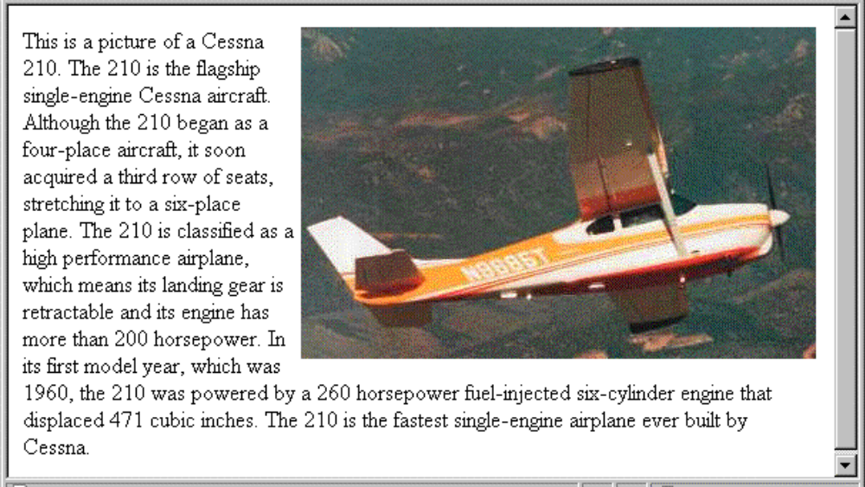
3.9 Alignment of Text (continued)
<img src = "c210.jpg"
style = "float: right" />
  Some text with the default alignment - left

Slide 35
3.10 The Box Model
Borders – every element has a border-style property
  Controls whether the element has a border and if so, the style of the border
  border-style values: none, dotted, dashed, and double
  The styles of one of the four sides of an element can be set using border-top-style, border-bottom-style, border-left-style and border-right-style
  border-width – thin, medium (default), thick, or a length value in pixels
  Border width can be specified for any of the four borders (e.g., border-top-width)
  border-color – any color can be given for the border
  Border color can be specified for any of the four borders (e.g., border-top-color)

Slide 36
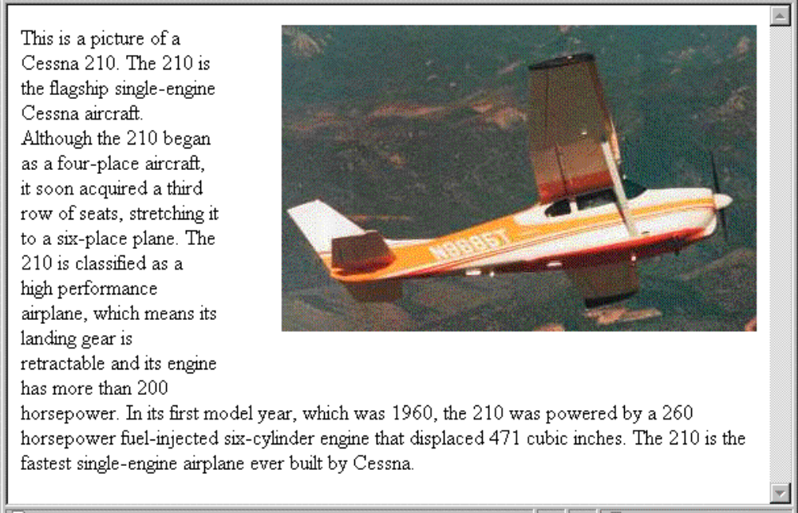
3.10 The Box Model (continued)
Margin – the space between the border of an element and its neighbor element
The margins around an element can be set with margin-left, etc. - just assign them a length value
<img src = "c210.jpg " style = "float: right;
margin-left: 0.35in;
margin-bottom: 0.35in" />
If you want to have the same value for all the margins then margin: value can be used
If you want to have the same value for all the padding then padding: value can be used

Slide 37
3.10 The Box Model (continued)
Padding – the distance between the content of an element and its border
  Controlled by padding, padding-left, etc.
3.11 Background Images
The background-image property
Repetition can be controlled
  background-repeat property
  Possible values: repeat (default), no-repeat, repeat-x, or repeat-y
  background-position property
    Possible values: top, center, bottom, left, or right

Slide 38
3.12 The <span> and <div> tags
One problem with the font properties is that they apply to whole elements, which are often too large
  Solution: a new tag to define an element in the content of a larger element - <span>
  The default meaning of <span> is to leave the content as it is
    <p>
    Now is the <span> best time </span> ever!
    </p>
  Use <span> to apply a document style sheet to its content
    <style type = "text/css">?
  bigred {font-size: 24pt;
  font-family: Ariel; color: red}
  </style>
  <p>
  Now is the
  <span class = "bigred">
  best time </span> ever!
  </p>

Slide 39
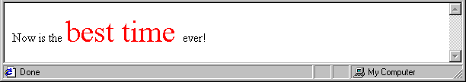
3.12 The <span> and <div> tags (continued)
The <span> tag is similar to other HTML tags, they can be nested and they have id and class attributes
Another tag that is useful for style specifications: <div>
  Used to create document sections (or divisions) for which style can be specified
    e.g., A section of five paragraphs for which you want some particular style

Slide 40
3.13 Conflict Resolution
When two or more rules apply to the same tag there are rules for deciding which rule applies
Document level
  In-line style sheets have precedence over document style sheets
  Document style sheets have precedence over external style sheets
Within the same level there can be conflicts
  A tag may be used twice as a selector
  A tag may inherit a property and also be used as a selector
Style sheets can have different sources
  The author of a document may specify styles
  The user, through browser settings, may specify styles
Individual properties can be specified as important
Example: p.special {font-style: italic !important; font-size:14pt;}

Slide 41
3.13 Precedence Rules
From highest to lowest
Important declarations with user origin
Important declarations with author origin
Normal declarations with author origin
Normal declarations with user origin
Any declarations with browser (or other user agent) origin
Sort by specificity
Id selectors
Class and pseudo-class selectors
Contextual selectors
Universal selectors

Slide 42
3.13 Tie-Breakers
Specificity
  id selectors
  Class and pseudo-class selectors
  Contextual selectors
  General selectors
Position
  Essentially, later has precedence over earlier
  Example:
  p {font-size: 12pt}
  P{font-size:10pt}
  The whole sorting process that is used to resolve style specification conflicts is called the Cascade.

Slide 43
Chapter 4
Basics of
JavaScript

Slide 44
JavaScript/EcmaScript References
The official EcmaScript, third edition, specification
  http://www.ecma-international.org/publications/files/ECMA-ST/Ecma-262.pdf
A working version of the 4th edition of the EcmaScript language specification
  http://www.carsoncheng.com/Ecma/tc39-tg1-2006-001.pdf
JavaScript as implemented in Mozilla products
  http://developer.mozilla.org/en/docs/JavaScript
Edition details can be found at the following site
  http://en.wikipedia.org/wiki/ECMAScript#cite_note-jsmoz-12
Details on how the browser and the engines work is given in the following site
  http://www.quora.com/JavaScript/How-does-a-JavaScript-engine-work#

Slide 45
4.1 Overview of JavaScript: Origins
Originally developed by Netscape as LiveScript
Joint Development with Sun Microsystems in 1995
Standard 262 (ECMA-262) of the European Computer Manufacturers Association
Supported by Netscape, Mozilla, Internet Explorer

Slide 46
Browsers, JavaScript and ECMA editions
Application | Latest version | ECMAScript edition
Google Chrome, the V8 engine | JavaScript | ECMA-262, edition 5
Mozilla Firefox, the Gecko layout engine, SpiderMonkey, and Rhino | JavaScript 1.8.5 | ECMA-262, edition 5
Safari, the Nitro engine | JavaScript | ECMA-262, edition 5.1

Slide 47
4.1 JavaScript Components
Core
  The heart of the language
Client-side
  Library of objects supporting browser control and user interaction
Server-side
  Library of objects that support use in web servers
Text focuses on Client-side

Slide 48
4.1 Java and JavaScript
Differences
  JavaScript has a different object model from Java
  JavaScript is not strongly typed
  Objects are dynamic in JavaScript
Java 1.6 has support for scripting
  http://java.sun.com/javase/6/docs/technotes/guides/scripting/index.html
SpiderMonkey is the code name for the first-ever JavaScript engine, written by Brendan Eich at Netscape Communications
Mozilla Rhino is an implementation of JavaScript in Java
  http://www.mozilla.org/rhino/

Slide 49
4.1 Uses of JavaScript
Provides alternative to server-side programming
  Servers are often overloaded
  Client processing has quicker reaction time
JavaScript can work with forms
JavaScript can access and modify the CSS properties and content of any element of a displayed XHTML document
JavaScript is used to provide more complex user interface than plain forms with HTML/CSS can provide
JavaScript can be used as a replacement to Java applets

Slide 50
4.1 Event-Driven Computation
Users actions, such as mouse clicks and key presses, are referred to as events
The main task of most JavaScript programs is to respond to events
For example, a JavaScript program could validate data in a form before it is submitted to a server
  Caution: It is important that crucial validation be done by the server. It is relatively easy to bypass client-side controls
  For example, a user might create a copy of a web page but remove all the validation code.

Slide 51
4.1 XHTML/JavaScript Documents
When JavaScript is embedded in an XHTML document, the browser must interpret it
Two locations for JavaScript server different purposes
  JavaScript in the head element will react to user input and be called from other locations
  JavaScript in the body element will be executed once as the page is loaded
Various strategies must be used to ‘protect’ the JavaScript from the browser
  For example, comparisons present a problem since < and > are used to mark tags in XHTML
  JavaScript code can be enclosed in XHTML comments

Slide 52
4.2 Object Orientation and JavaScript
JavaScript does not have classes
JavaScript is object-based
  JavaScript defines objects that encapsulate both data and processing
  However, JavaScript does not have true inheritance
JavaScript provides prototype-based inheritance
No polymorphism

Slide 53
4.2 JavaScript Objects
Objects are collections of properties
Properties are either data properties or method properties
Data properties are either primitive values or references to other objects
Primitive values are often implemented directly in hardware (nonobject types)
The root object in JavaScript is object, is the ancestor of all objects in a program
  object has no data properties, but several method properties
Object appears both internally or externally as the collection of property/value pairs
Collection of properties of a JavaScript is dynamic

Slide 54
4.3 JavaScript in XHTML
Directly embedded
  <script type=“text/javascript”>
  <!--
  …Javascript here…
  // -->
  </script>
Indirect reference
  <script type=“text/javascript” src=“tst_number.js”/>
  This is the preferred approach

Slide 55
4.3 General Syntactic Characteristics
JavaScript can appear directly as the content of a <script> tag
The type attribute must be set to “text/javascript”
It can be indirectly embedded in XHTML document using the src attribute of <script>
  Example
    <script type=“text/javascript” src=“test_num.js”>
    </script>
And requires the closing tag always

Slide 56
4.3 General Syntactic Characteristics contd…
Identifiers
  Start with $, _, letter
  Continue with $, _, letter or digit
  Case sensitive
Reserved words are 25 example: break, case catch, throw etc…
Another collection of words is reserved for future use in JavaScript--- Can be found in ECMA web site.
Comments
  //
  /* … */

Slide 57
4.3 Statement Syntax
Statements can be terminated with a semicolon
However, the interpreter will insert the semicolon if missing at the end of a line and the statement seems to be complete
Can be a problem:
  return
  x;
If a statement must be continued to a new line, make sure that the first line does not make a complete statement by itself
Example hello.html

Slide 58
4.4 Primitive Types
Five primitive types
  Number
  String
  Boolean
  Undefined
  Null
There are five classes corresponding to the five primitive types
  Wrapper objects for primitive values
  Place for methods and properties relevant to the primitive types
  Primitive values are coerced to the wrapper class as necessary, and vice-versa

Slide 59
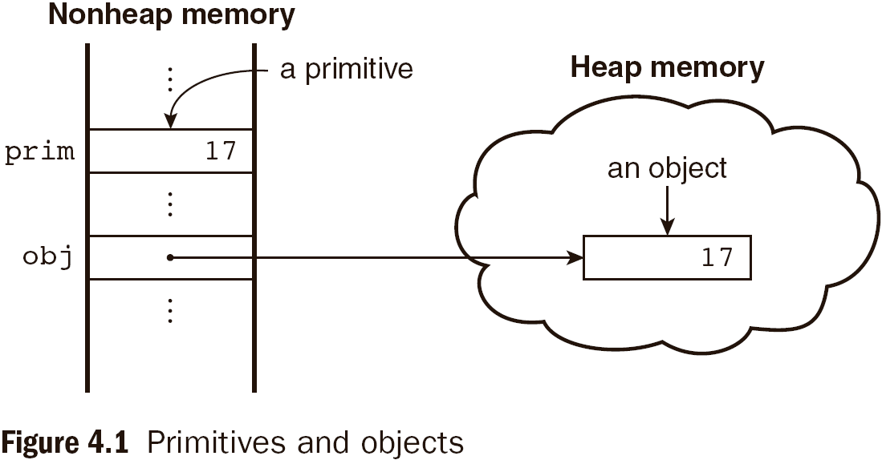
4.4 Primitive and Object Storage

Slide 60
4.4 Numeric and String Literals
Number values are represented internally as double-precision floating-point values.
This format stores numbers in 64 bits, where the number (the fraction) is stored in bits 0 to 51, the exponent in bits 52 to 62, and the sign in bit 63
  Number literals can be either integer or float
  Float values may have a decimal and/or exponent
  eg: 12 1.2 .12 12. 1E2 1e2 .1e2 1.e2 1.2E-2
  These can also be written in hex form by preceding their first digit with 0x or OX.
A String literal is delimited by either single or double quotes
  There is no difference between single and double quotes
  Certain characters may be escaped in strings
    \’ or \” to use a quote in a string delimited by the same quotes
    \\ to use a literal backspace
  The empty string ‘’ or “” has no characters

Slide 61
4.4 Other Primitive Types
Null
  A single value, null
  null is a reserved word
  A variable that is used but has not been declared nor been assigned a value has a null value
  Using a null value usually causes an error
Undefined
  A single value, undefined
  However, undefined is not, itself, a reserved word
  The value of a variable that is declared but not assigned a value
Boolean
  Two values: true and false

Slide 62
4.4 Declaring Variables
JavaScript is dynamically typed, that is, variables do not have declared types
  A variable can hold different types of values at different times during program execution
A variable can be declared either by assigning it a value or by listing it in a declaration statement that begins with a keyword var
  var counter,
  index,
  pi = 3.14159265,
  quarterback = "Elway",
  stop_flag = true;

Slide 63
4.4 Numeric Operators
Standard arithmetic
  + * - / %
Increment and decrement
  -- ++
  Increment and decrement differ in effect when used before and after a variable
  Assume that a has the value 3, initially
  (++a) * 3 has the value 24
  (a++) * 3 has the value 27
  a has the final value 8 in either case

Slide 64
4.4 Precedence of Operators
Operators | Associativity
++, --, unary - | Right
*, /, % | Left
+, - | Left
>, <, >= ,<= | Left
==, != | Left
===,!== | Left
&& | Left
|| | Left
=, +=, -=, *=, /=, &&=, ||=, %= | Right

Slide 65
4.4 Example of Precedence
var a = 2,
b = 4,
c,
d;
c = 3 + a * b;
// * is first, so c is now 11 (not 24)
d = b / a / 2;
// / associates left, so d is now 1 (not 4)

Slide 66
4.4 The Math Object
Provides a collection of properties of Number object and methods which operate on Number objects
This includes the trigonometric functions such as sin and cos
Other methods are floor, round, max etc.
When used, the methods must be referenced through the Math object, as in Math.sin(x)

Slide 67
4.4 The Number Object
Properties
  MAX_VALUE
  MIN_VALUE
  NaN
  POSITIVE_INFINITY
  NEGATIVE_INFINITY
  PI
Operations resulting in errors return NaN
  Dividing zero by zero for example
toString() method converts a number to a string

Slide 68
4.4 String Catenation
The operation + is the string catenation operation
In many cases, other types are automatically converted to string
Example:
var str = “first”;
var str1 = str + “second”;

Slide 69
4.4 Implicit Type Conversion
JavaScript attempts to convert values in order to be able to perform operations
“August “ + 1977 causes the number to be converted to string and a concatenation to be performed
7 * “3” causes the string to be converted to a number and a multiplication to be performed
null is converted to 0 in a numeric context, undefined to NaN
0 is interpreted as a Boolean false, all other numbers are interpreted as true
The empty string is interpreted as a Boolean false, all other strings (including “0”!) as Boolean true
undefined, Nan and null are all interpreted as Boolean false

Slide 70
4.4 Explicit Type Conversion
Type conversion primarily between strings and numbers
String that contain numbers can be converted to numbers using the String constructor
Example:
var str = String(value);
Explicit conversion of string to number
  var number = Number(aString)
  var number = aString – 0
  Number in the string must not be followed by any character apart from space
Number can also be converted to string by catenating it with the empty string
parseInt and parseFloat convert the beginning of a string but do not cause an error if a non-space follows the numeric part

Slide 71
4.4 String Properties and Methods
One property: length
  Note to Java programmers, this is not a method!
Example:
var str= “george”;
var len = str.length;
Large collection of methods
Character positions in strings begin at index 0

Slide 72
4.4.11 String Methods
Method | Parameters | Result
charAt | A number | Returns the character in the String object that is at the specified position
indexOf | One-character string | Returns the position in the String object of the parameter
substring | Two numbers | Returns the substring of the String object from the first parameter position to the second
toLowerCase | None | Converts any uppercase letters in the string to lowercase
toUpperCase | None | Converts any lowercase letters in the string to uppercase

Slide 73
4.4 The typeof Operator
Returns “number” or “string” or “boolean” for primitive types
Returns “object” for an object or null
Two syntactic forms
  typeof x
  typeof(x)
If the operand is a variable which has not been assigned a value, typeof evaluates to “undefined”
typeof operator always returns a string

Slide 74
4.4 Assignment Statements
Plain assignment indicated by =
Compound assignment with
  += -= /= *= %= …
a += 7 means the same as
a = a + 7

Slide 75
4.4 The Date Object
A Date object represents a time stamp, that is, a point in time
A Date object is created with the new operator
  var now= new Date();
  This creates a Date object for the time at which it was created
The date and time properties of a Date object are in two forms: local and UTC

Slide 76
4.4 The Date Object: Methods
toLocaleString | A string of the Date information
getDate | The day of the month
getMonth | The month of the year, as a number in the range of 0 to 11
getDay | The day of the week, as a number in the range of 0 to 6
getFullYear | The year
getTime | The number of milliseconds since January 1, 1970
getHours | The number of the hour, as a number in the range of 0 to 23
getMinutes | The number of the minute, as a number in the range of 0 to 59
getSeconds | The number of the second, as a number in the range of 0 to 59
getMilliseconds | The number of the millisecond, as a number in the range of 0 to 999

Slide 77
4.5 Screen Output and Keyboard Input
Standard output for JavaScript is the same as the screen in which the content of the host XHTML document is displayed
JavaScript models the XHTML document with the Document object.
The write method of the Document object writes its parameters to the browser window
If a line break is needed in the output, use <br /> into the output

Slide 78
4.5 Window and Document
The Window object represents the window in which the document containing the script is being displayed
The Document object represents the document being displayed using DOM
Window has two properties
  window refers to the Window object itself
  document refers to the Document object
The Window object is the default object for JavaScript, so properties and methods of the Window object may be used without qualifying with the class name

Slide 79

4.5 The alert Method
The alert method opens a dialog box with a message
The output of the alert is not XHTML, so use new lines rather than <br/>
alert("The sum is:" + sum + "\n");

Slide 80
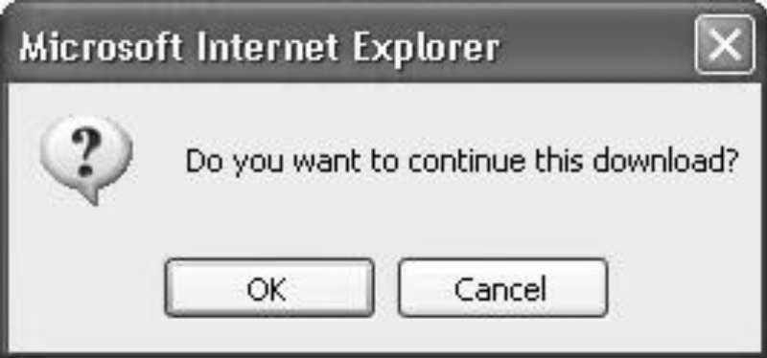
4.5 The confirm Method
The confirm methods displays a message provided as a parameter
  The confirm dialog has two buttons: OK and Cancel
If the user presses OK, true is returned by the method
If the user presses Cancel, false is returned
var question =
confirm("Do you want to continue this download?");

Slide 81
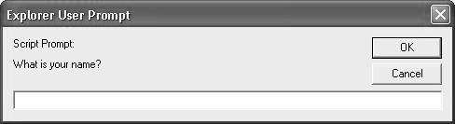
4.5 The prompt Method
This method displays its string argument in a dialog box
  A second argument provides a default content for the user entry area
The dialog box has an area for the user to enter text
The method returns a String with the text entered by the user
name = prompt("What is your name?", "");

Slide 82
4.6 Control Statements
A compound statement in JavaScript is a sequence of 0 or more statements enclosed in curly braces
  Compound statements can be used as components of control statements allowing multiple statements to be used where, syntactically, a single statement is specified
A control construct is a control statement including the statements or compound statements that it contains

Slide 83
4.6 Control Expressions
A control expression has a Boolean value
  An expression with a non-Boolean value used in a control statement will have its value converted to Boolean automatically
Comparison operators
  == != < <= > >=
  === compares identity of values or objects
  3 == ‘3’ is true due to automatic conversion
  3 === ‘3’ is false
Boolean operators
  && || !
Warning! A Boolean object evaluates as true
  Unless the object is null or undefined

Slide 84
4.6 Selection Statements
The if-then and if-then-else are similar to that in other programming languages, especially C/C++/Java

Slide 85
4.6 switch Statement Syntax
switch (expression) {
case value_1:
// statement(s)
case value_2:
// statement(s)
...
[default:
// statement(s)]
}

Slide 86
4.6 switch Statement Semantics
The expression is evaluated
The value of the expressions is compared to the value in each case in turn
If no case matches, execution begins at the default case
Otherwise, execution continues with the statement following the case
Execution continues until either the end of the switch is encountered or a break statement is executed

Slide 87
4.6 Loop Statements
Loop statements in JavaScript are similar to those in C/C++/Java
While
  while (control expression)
  statement or compound statement
For
  for (initial expression; control expression; increment expression)
  statement or compound statement
do/while
  do statement or compound statement
  while (control expression)

Slide 88
4.6 date.js Example
Uses Date objects to time a calculation
Displays the components of a Date object
Illustrates a for loop

Slide 89
4.6 while Statement Semantics
The control expression is evaluated
If the control expression is true, then the statement is executed
These two steps are repeated until the control expression becomes false
At that point the while statement is finished

Slide 90
4.6 for Statement Semantics
The initial expression is evaluated
The control expression is evaluated
If the control expression is true, the statement is executed
Then the increment expression is evaluated
The previous three steps are repeated as long as the control expression remains true
When the control expression becomes false, the statement is finished executing

Slide 91
4.6 do/while Statement Semantics
The statement is executed
The control expression is evaluated
If the control expression is true, the previous steps are repeated
This continues until the control expression becomes false
At that point, the statement execution is finished

